Slide 1
CS 4530
Software Engineering
Lesson 10: Software Engineering & Security
Jonathan Bell, Adeel Bhutta, Ferdinand Vesely, Mitch Wand
Khoury College of Computer Sciences
© 2022, released under CC BY-SA
Notes:
Hi, In this lesson, we’ll begin to investigate security concerns in software engineering - starting with a discussion of security threats.

Slide 2
Learning Objectives for this Lesson
By the end of this lesson, you should be able to…
Describe that security is a spectrum, and be able to define a realistic threat model for a given system
Evaluate the tradeoffs between security and costs in software engineering
Recognize the causes of and common mitigations for common vulnerabilities in web applications
Utilize static analysis tools to identify common weaknesses in code

Slide 3
Outline:
What is a threat model?
What are the primary categories of threats for software systems?
Techniques for mitigating threats
Costs and tradeoffs of mitigations

Slide 4
Security as non-functional requirements
CIA: An overview of security properties
Confidentiality: is information disclosed to unauthorized individuals?
Integrity: is code or data tampered with?
Availability: is the system accessible and usable?
Notes:
Security is often considered a broad functional requirement: systems are expected to be “secure”. As we’ll see in this lecture, security is a spectrum from “very secure” to ”not very secure”, but it’s also a spectrum in terms of the kind of security requirements that we consider. Here are three common security requirements.
Confidentiality - is information disclosed to unauthorized parties? This is not privacy, because the end-user doesn’t get to make a choice. Might make privacy a sub-requirement of confidentiality
Integrity - is our code or data tampered with, at rest, or in transit? usually more of a commercial interest. Someone downloads my customer database is not as bad to my business as someone destroying it
Availability - Can someone prevent my system from otherwise functioning? note that leaving something unplugged solves confidentiality and integrity :)
Discussion: Think about recent examples of security vulnerabilities and how they violated these properties

Slide 5

Security isn't (always) free
In software, as in the real world…
You just moved to a new house, someone just moved out of it. What do you do to protect your belongings/property?
Do you change the locks?
Do you buy security cameras?
Do you hire a security guard?
Do you even bother locking the door?
Notes:
Before getting into software security, let’s talk a bit about physical security. Imagine that you have just moved to a new house, and someone just moved out. Are there things that you would want to do to secure your belongings? For instance - do you change the locks? Maybe you are concerned that the former tenant still has keys.
(Walk through example, then ultimately point out that you live in a house with lots of glass: should you put grates on the windows, or replace them with blast doors??)

Slide 6
Security is about managing risk
Vocabulary
Security architecture is a set of mechanisms and policies that we build into our system to mitigate risks from threats
Threat: potential event that could compromise a security requirement
Attack: realization of a threat
Vulnerability: a characteristic or flaw in system design or implementation, or in the security procedures, that, if exploited, could result in a security compromise
Notes:
(Read slide)
A vulnerability is an instance of an undefended threat in a system.
This lesson will focus on threats. The following lesson will focus on detecting and removing vulnerabilities
==================
FOR NEXT TIME: need to regularize this vocabulary, also mention “attack surface” (= a characteristic of a system that may pose a vulnerability?)

Slide 7
Security is about managing risk
Cost of attack vs cost of defense?
Increasing security might:
Increase development & maintenance cost
Increase infrastructure requirements
Degrade performance
But, if we are attacked, increasing security might also:
Decrease financial and intangible losses
So: How likely do we think we are to be attacked in way X?
Notes:
We saw in the example of the new home that there may be some security measures that seem needlessly expensive (hiring a security guard) or expensive AND counter to some of our other requirements (replacing glass windows with blast doors increases security at the expense of aesthetics).
Here are some examples of the kinds of tradeoffs that we might consider when thinking about these threats .(read slide)
Ultimately, the last question of “how likely we are to be attacked in some way” is going to be very subjective, and we will need to consider the financial cost of a successful attack – attacks with very large payoffs (for the attacker) might motivate attackers to try harder.

Slide 8
A Threat Model forces us to answer 3 key questions:
What is important to defend?
Who do we trust?
What processes do we institute to protect our code and data?

Slide 9
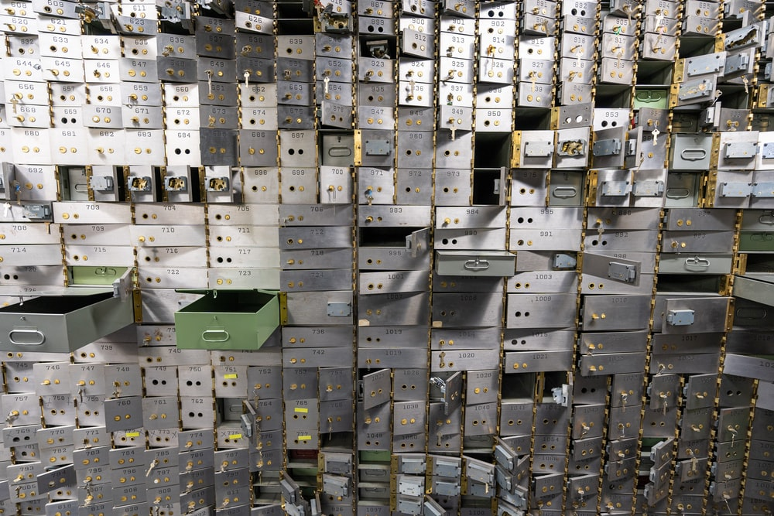
Thread Model: What is important to defend?
What value can an attacker extract from a vulnerability?
What is being defended?
What resources are important to defend?
Does our code contain any sensitive data?
What is the cost if that data is breached or tampered with?
Even if your code is not “sensitive”: does it expose other routes of attack?
Notes:
Growing trend of political mayhem-inducing attacks: even if not stealing sensitive information, disabling many services simultaneously may be an objective for a nation-state scale attacker.
-------------

Slide 10
Threat Model: Who do we trust?
What entities or parts of system can be considered secure and trusted?
Have to trust something!
Never trust remote users (especially remote users!)
Notes:
(read slide)
Note: Usually we trust our own code to be bug-free. That’s usually not a very good assumption, but if there’s a vulnerability in our code, at least we can fix it– hopefully before somebody attacks it.

Slide 11
Threat Model: Processes
What processes do we institute to protect our code and data?
How often do we review our code for security?
How often do we review our partners’ security practices?
Notes:
A threat model must also include *processes*, because the security environment may change: someone may discover that some service we use has a security problem or one of our partners might change their security practices in a way that we find unacceptable,.

Slide 12
Creating a Reasonable Threat Model
Best practices applicable in most situations
Trust:
Developers writing our code
Server running our code
Popular dependencies that we use and update
Don’t trust:
Code running in browser
Inputs from users
Practice good security practices:
Encryption (all data in transit, sensitive data at rest)
Code signing, multi-factor authentication
Bring in security experts early for riskier situations
Notes:
Here are some general best practices, applicable in most situations.

Slide 13
Part 2: Categories of Threats
Code that runs in an untrusted environment
Untrusted data flowing into our trusted codebase
Threats coming from the software supply chain (dependency on untrusted code)
Notes:
Let’s move on to the kinds of threats that we might want to defend against. Most threats can be grouped into three rough categories (read slide).

Slide 14

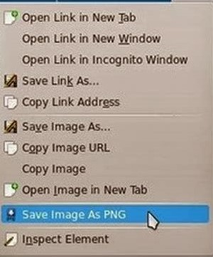
Threat: code that runs in an untrusted environment
Notes:
If you expose some important data to an untrusted user, how do you prevent them from doing things with it that you don’t want.
Let’s say you are Netflix (or Spotify or Apple Music). Can you prevent the user from downloading the movie to their local machine? Can you prevent them from taking their iPhone and recording the images on the screen?
DRM, or Digital Rights Management, is all about addressing this problem.

Slide 15
Threat: Code that runs in an untrusted environment
Authentication code in a web application
function checkPassword(inputPassword: string){
if(inputPassword === 'letmein'){
return true;
}
return false;
}
Should this go in our frontend code?
Notes:
Here’s a more down-to-earth example: Code that can be controlled by user (e.g. code that runs on a user’s device). Once we download the code to a user’s machine, it’s hard to control what the user does with it. Can they decompile it and retrieve the hard-coded password? We can make that hard, but we can’t always prevent it. Some machines have hardware DRM chips installed, but not all do.
(read slide)
Should this go in our frontend code? No, no way!

Slide 16


Threat: Code that runs in an untrusted environment
Authentication code in a web application
Frontend
Users might be malicious
Trust boundary
We control this side
Backend
function checkPassword(inputPassword: string){
if(inputPassword === 'letmein'){
return true;
}
return false;
}
Notes:
This one is easy to fix: move that sensitive code into our backend, which we should, hopefully, trust to faithfully execute the code

Slide 17

Threat: Code that runs in an untrusted environment
HTTP Request
Do I trust that this request really came from the user?
HTTP Response
Do I trust that this response really came from the server?
client page
(the “user”)
Do I trust the server to give me the right answer?
server
Do I trust the server to not send my data somewhere else?
Notes:
From the point of view of the server, the user is malicious. But there are lots of trust relationships here: does the server trust that this request really came from the user? Does the user trust that response really came from the server? Does the user trust that the server’s response is honest? Does the user trust the server not to leak the user’s data to some third party (e.g. Zoom apparently was leaking data to Facebook at one point).

Slide 18
Threat: Data controlled by a user flowing into our trusted codebase
https://xkcd.com/327/
Notes:
The next class of threat that we will consider is untrusted user inputs. Imagine that we have solved our problem of “do we trust where the code runs” by running that code on our own server that we control. Surely, we still receive inputs from users, who we might not trust.
Here is a pop-culture reference from XKCD that makes jest of this class of threat

Slide 19
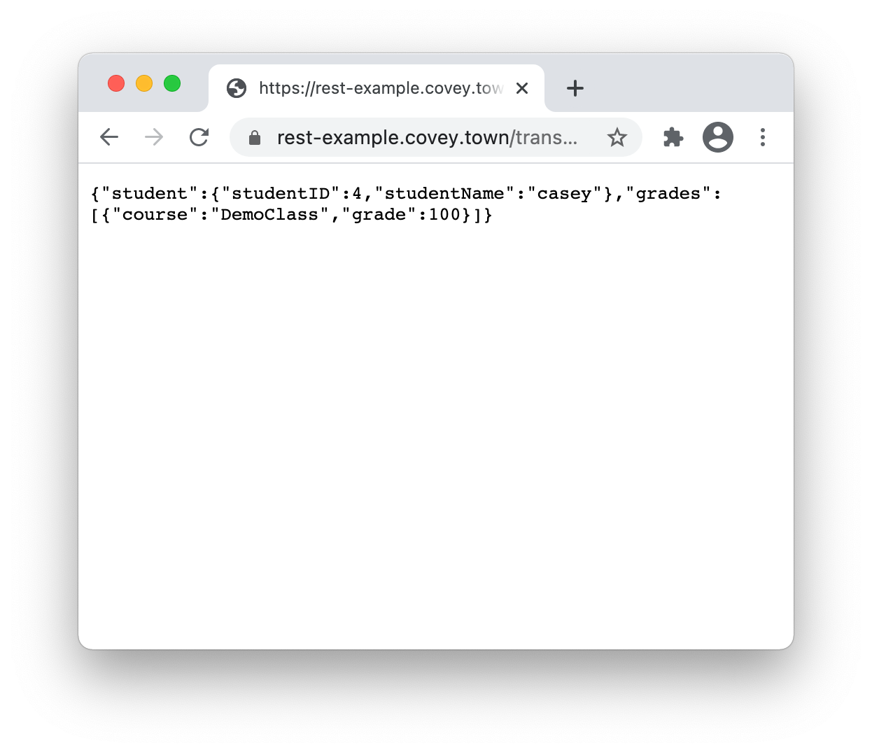
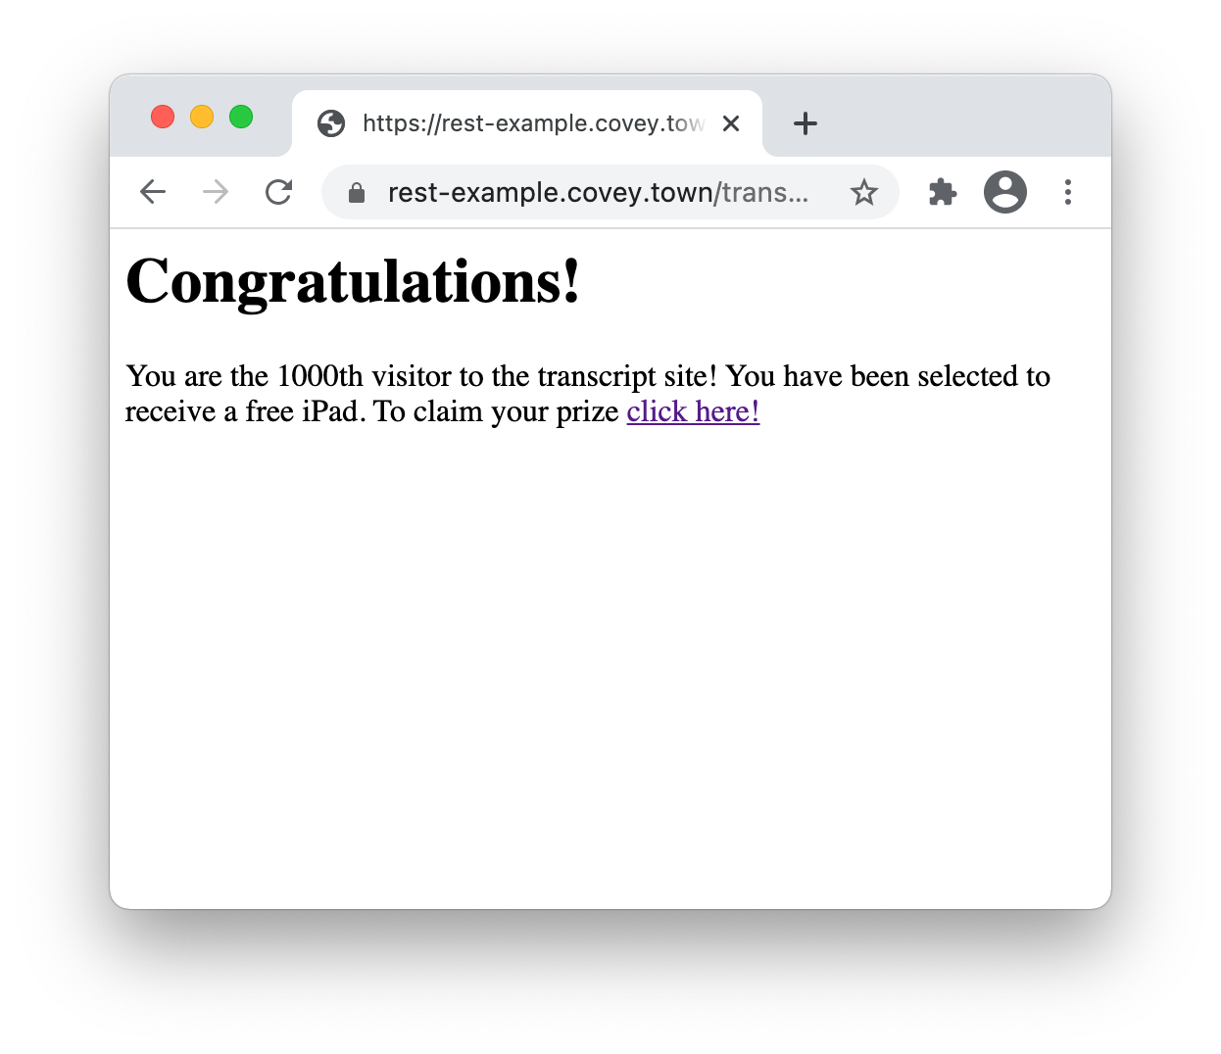
Threat: Data controlled by a user flowing into our trusted codebase
Cross-site scripting (XSS)
Trusted Server
Malicious JavaScript Response
Notes:
Here is a concrete example of how this threat can be realized in a common web app, even one that doesn’t use a database. (remind of purpose of transcript server ,what this graphic shows)
Click build: We’ll see how it is possible for a malicious attacker to create a link to our own rest example transcript server that, when accessed, shows content that we (the authors of the transcript server) did not intend

Slide 20
Threat: Data controlled by a user flowing into our trusted codebase
app.get('/transcripts/:id', (req, res) => {
// req.params to get components of the path
const {id} = req.params;
const theTranscript = db.getTranscript(parseInt(id));
if (theTranscript === undefined) {
res.status(404).send(`No student with id = ${id}`);
}
{
res.status(200).send(theTranscript);
}
});
Cross-site scripting (XSS)
Trusted Server
/transcripts/4
Notes:
How do such threats occur?
Here is the code for the express handler that generates the page in the screenshot.

Slide 21
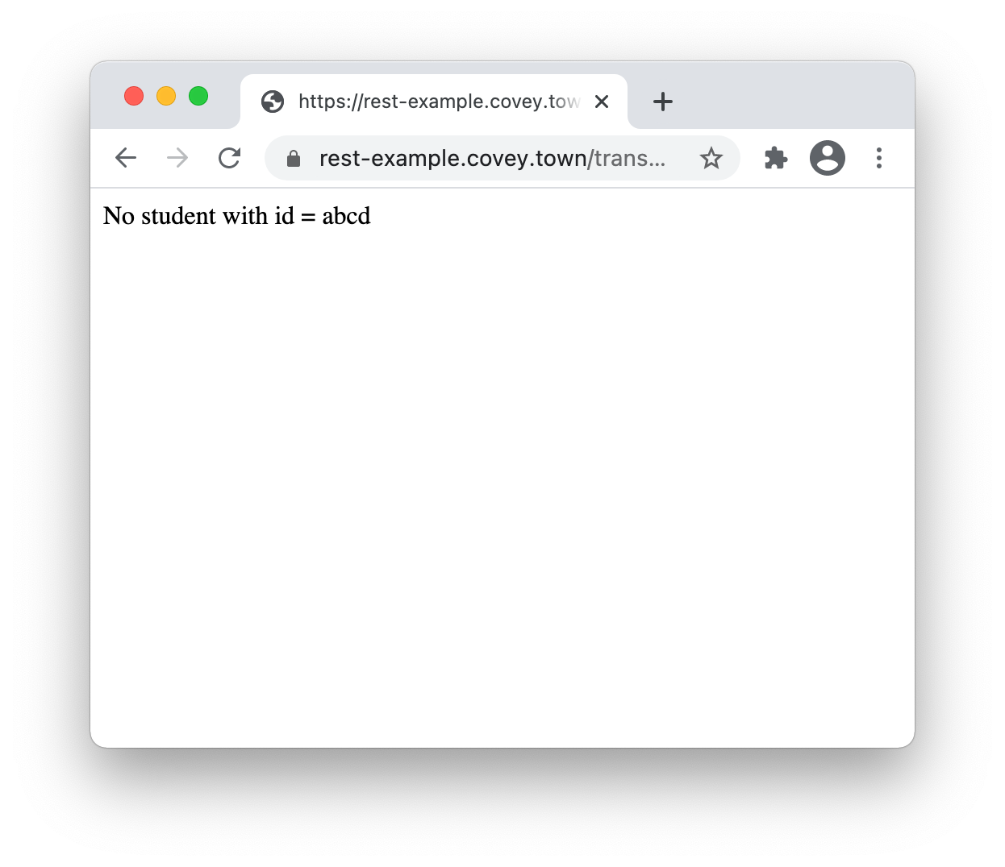
Threat: Data controlled by a user flowing into our trusted codebase
app.get('/transcripts/:id', (req, res) => {
// req.params to get components of the path
const {id} = req.params;
const theTranscript = db.getTranscript(parseInt(id));
if (theTranscript === undefined) {
res.status(404).send(`No student with id = ${id}`);
}
{
res.status(200).send(theTranscript);
}
});
Cross-site scripting (XSS)
Trusted Server
/transcripts/abcd
Notes:
Notice that there is a user input (the student ID) that flows directly into the response

Slide 22
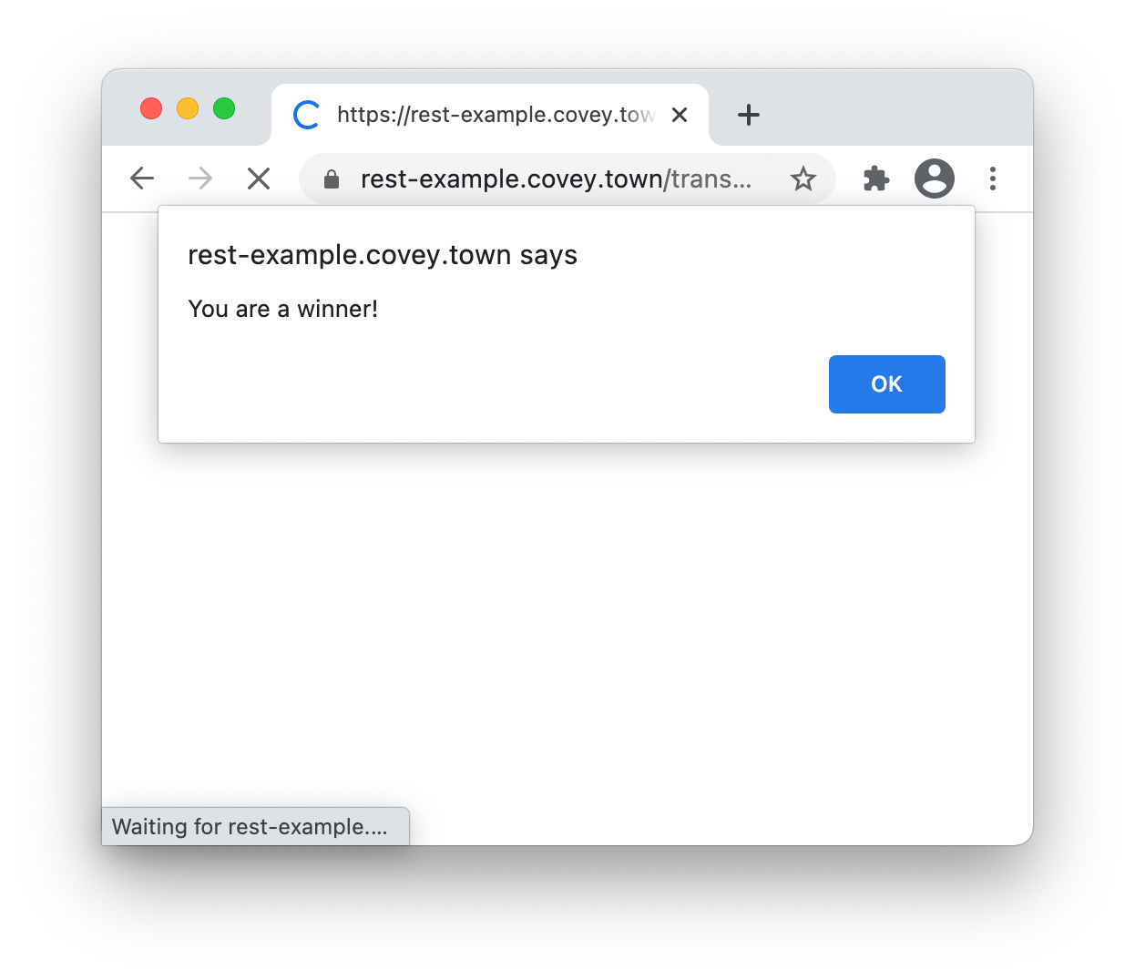
Threat: Data controlled by a user flowing into our trusted codebase
app.get('/transcripts/:id', (req, res) => {
// req.params to get components of the path
const {id} = req.params;
const theTranscript = db.getTranscript(parseInt(id));
if (theTranscript === undefined) {
res.status(404).send(`No student with id = ${id}`);
}
{
res.status(200).send(theTranscript);
}
});
Cross-site scripting (XSS)
https://rest-example.covey.town/transcripts/%3Ch1%3ECongratulations!%3C/h1%3E You are the 1000th …
Trusted Server
/transcripts/%3Ch1%3e…
<h1>Congratulations!</h1>
You are the 1000th visitor to the transcript site! You have been selected to receive a free iPad. To claim your prize <a href='https://www.youtube.com/watch?v=DLzxrzFCyOs'>click here!</a>
<script language=“javascript”>
document.getRootNode().body.innerHTML=
'<h1>Congratulations!</h1>You are the 1000th visitor to the transcript site! You have been selected to receive a free iPad. To claim your prize <a href="https://www.youtube.com/watch?v=DLzxrzFCyOs">click here!</a>’;
alert('You are a winner!’);
</script>
Notes:
If, instead of submitting a simple number, the user submits a malicious string like this one, it will allow the attacker to render html of their choosing on the user’s page. When the server returns the 404, the browser renders the error message that came along with it, which includes the malicious html shown.
When you open this link in Chrome, it will show the alert on the left, and then the message on the right. (Safari will reject this, but some sites actually depend on executing JS from the input)
Realistic XSS attacks might use this JS code to steal users’ credentials from their browser tab, or to perform a social engineering attack like this one

Slide 23
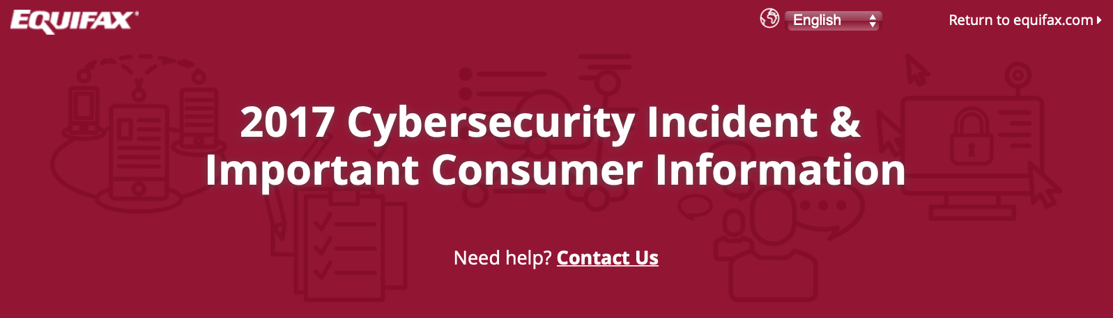
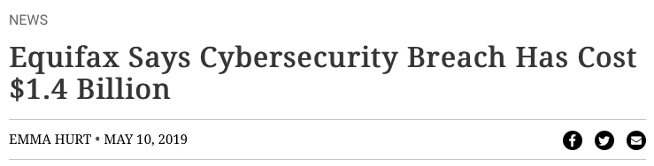
Threat: Data controlled by a user flowing into our trusted codebase
Java code injection in Apache Struts (@Equifax)
CVE-2017-5638 Detail
Current Description
The Jakarta Multipart parser in Apache Struts 2 2.3.x before 2.3.32 and 2.5.x before 2.5.10.1 has incorrect exception handling and error-message generation during file-upload attempts, which allows remote attackers to execute arbitrary commands via a crafted Content-Type, Content-Disposition, or Content-Length HTTP header, as exploited in the wild in March 2017 with a Content-Type header containing a #cmd= string.
Notes:
Untrusted user inputs can flow into even more risky parts of our app. For example: the Equifax data breach in 2017 that has thus-far cost the firm over 1.4 billion dollars was caused by a vulnerability in their web app, which allowed untrusted user input to flow into a part of the application that would then execute that input as java code.

Slide 24
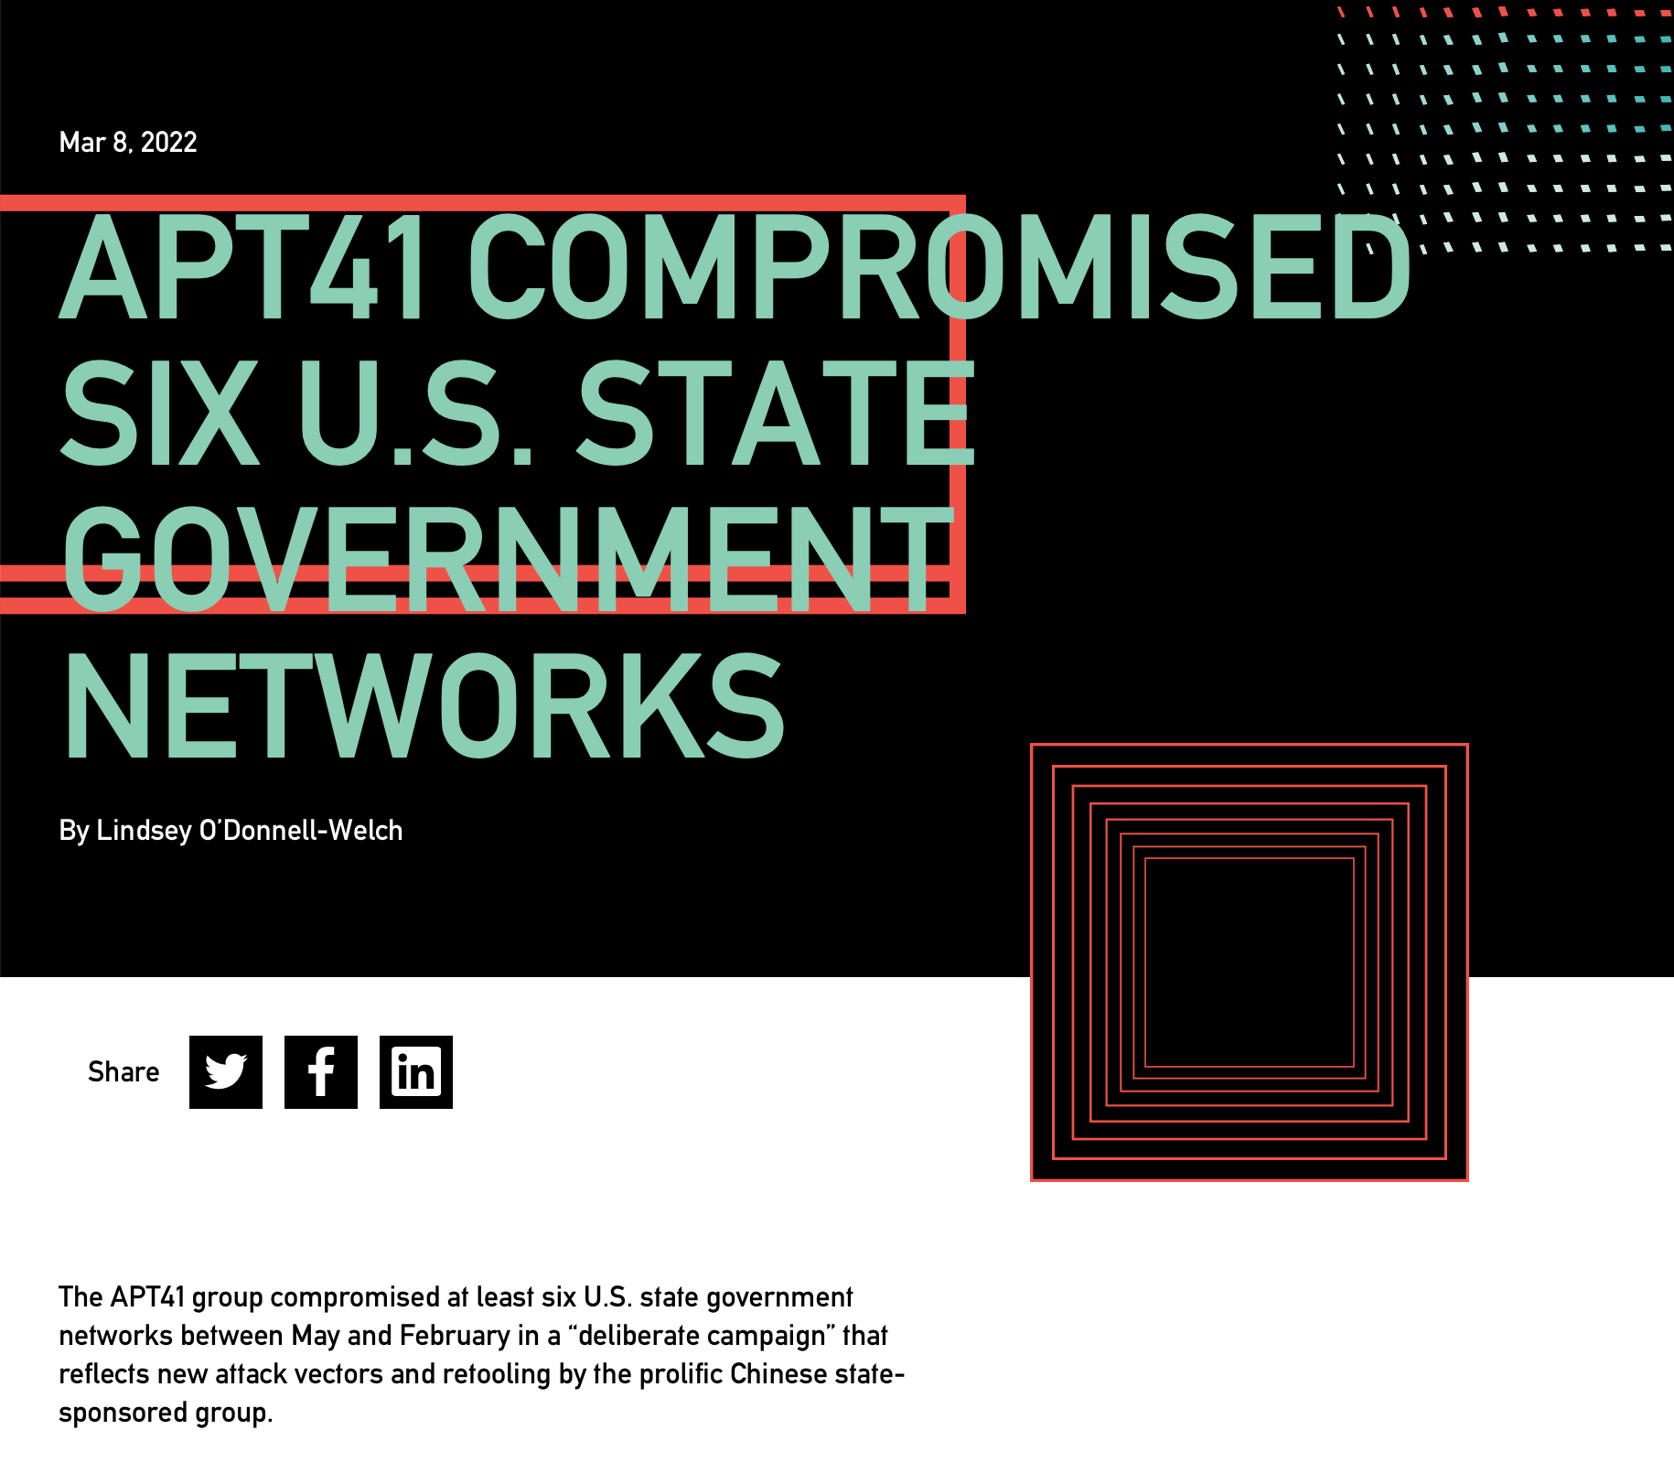
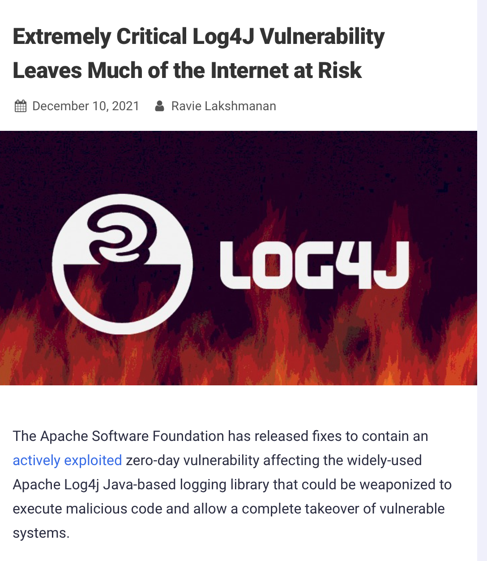
Threat: Data controlled by a user flowing into our trusted codebase
Java code injection in Log4J
CVE-2021-44228 Detail
Current Description
Apache Log4j2 2.0-beta9 through 2.15.0 (excluding security releases 2.12.2, 2.12.3, and 2.3.1) JNDI features used in configuration, log messages, and parameters do not protect against attacker controlled LDAP and other JNDI related endpoints. An attacker who can control log messages or log message parameters can execute arbitrary code loaded from LDAP servers when message lookup substitution is enabled. From log4j 2.15.0, this behavior has been disabled by default. From version 2.16.0 (along with 2.12.2, 2.12.3, and 2.3.1), this functionality has been completely removed. Note that this vulnerability is specific to log4j-core and does not affect log4net, log4cxx, or other Apache Logging Services projects.
https://nvd.nist.gov/vuln/detail/CVE-2021-44228
https://thehackernews.com/2021/12/extremely-critical-log4j-vulnerability.html
https://duo.com/decipher/apt41-compromised-six-state-government-networks
Notes:
You might think that we have learned a lesson and that we wouldn’t have this kind of vulnerability any more. As we will see in the next lesson, fully protecting against vulnerabiltieis like these is hard. The Log4J vulnerability this past fall was successfully used to compromise many networks, and (click build) was also due to an issue where user-controlled inputs could be executed as code on a trusted component (the directory/LDAP server in this case)

Slide 25
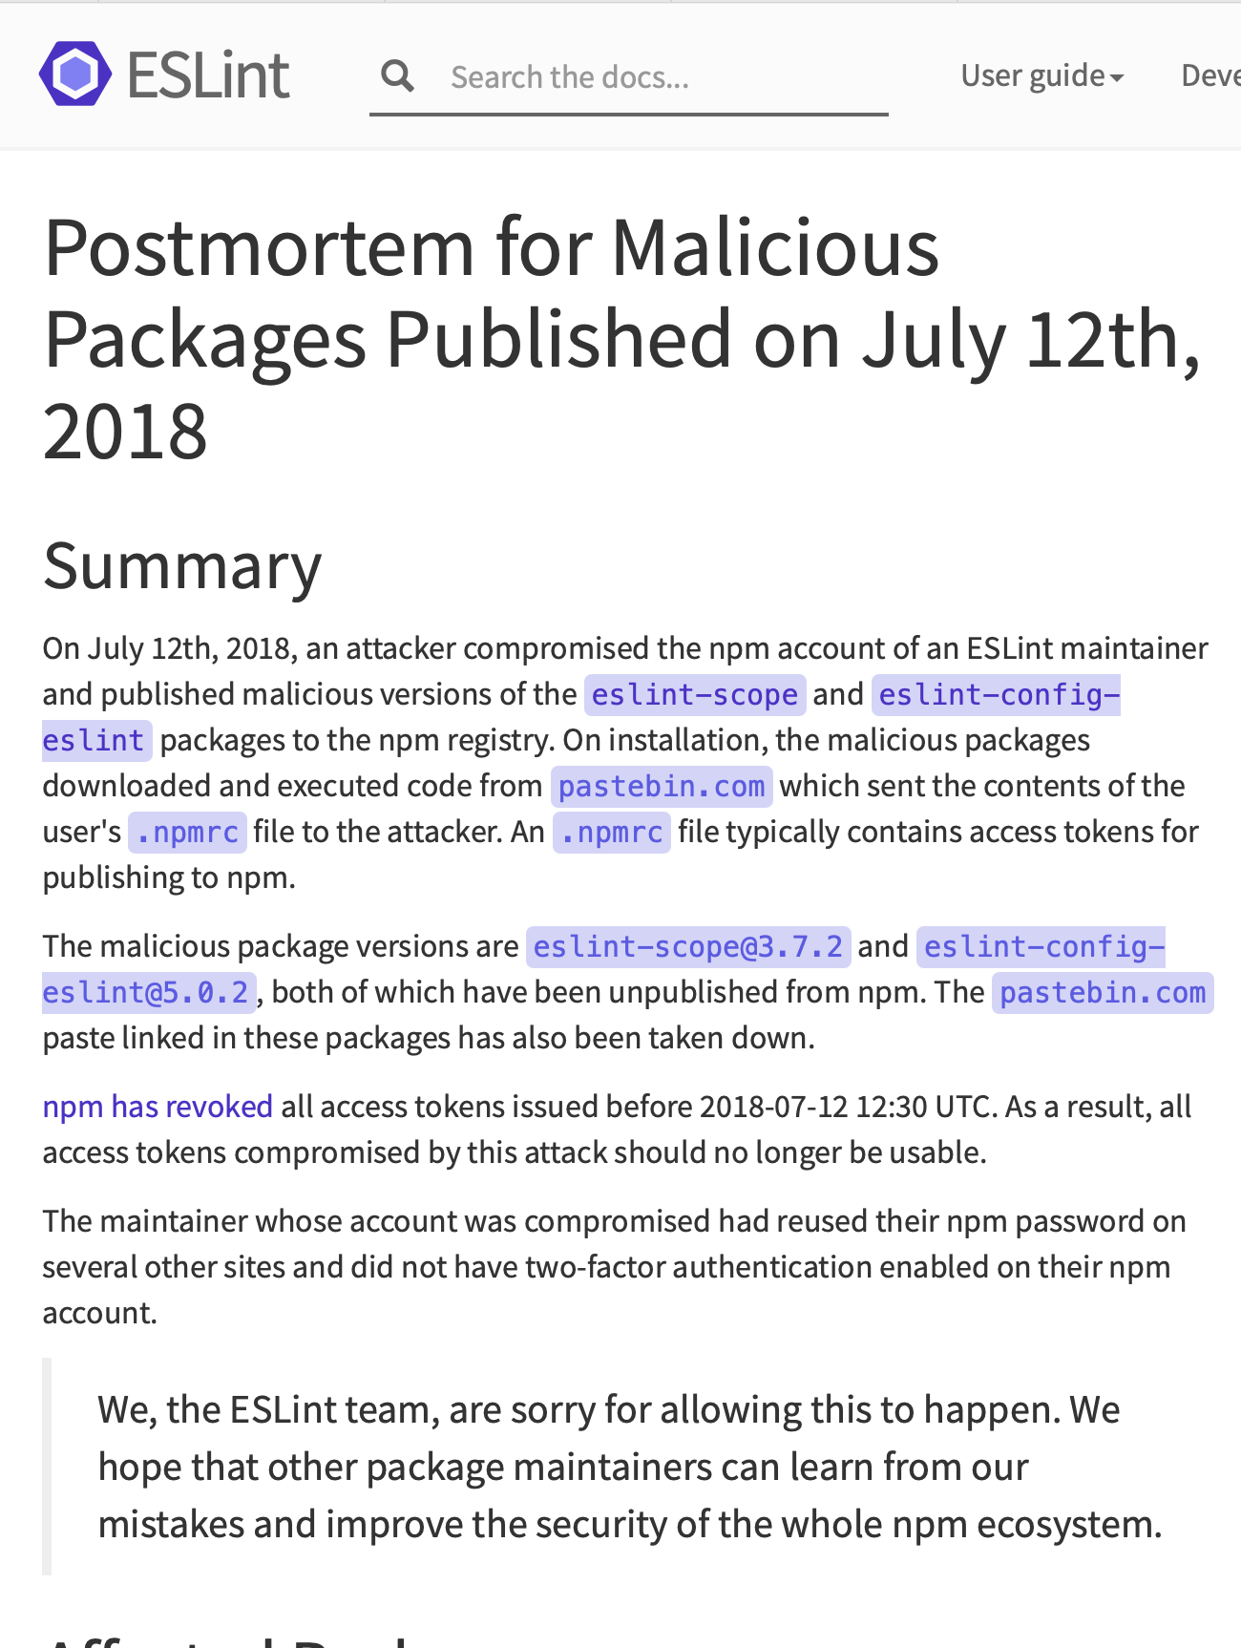
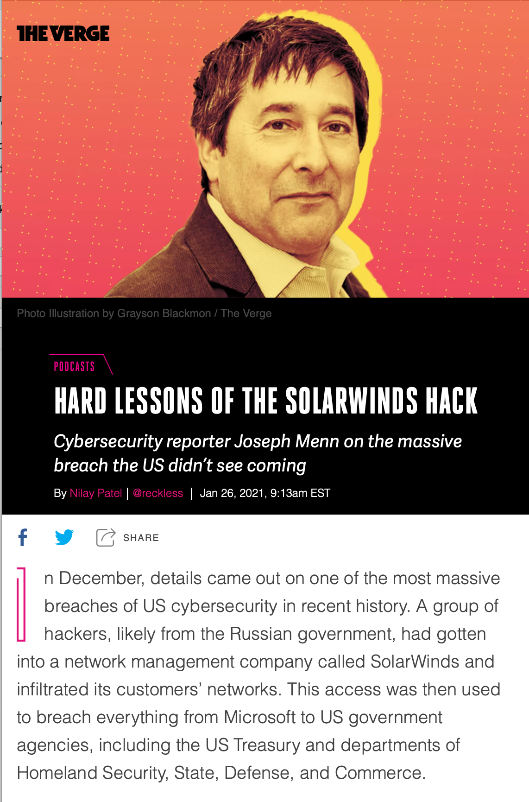
Threat Category 3: Software Supply Chain
Do we trust our own code? Third-party code provides an attack vector
https://www.theverge.com/2021/1/26/22248631/solarwinds-hack-cybersecurity-us-menn-decoder-podcast
https://eslint.org/blog/2018/07/postmortem-for-malicious-package-publishes
Notes:
Lastly, we will consider, broadly, so-called software supply chain threats. This category of threat captures everything bad that might happen when we develop software.
For example:
(Left) We often rely on many third-party dependencies. A motivated attacker might be able to (through some other vulnerabilities) be able to publish a malicious version of that package. There was a quite serious issue when a malicious version of an eslint package, eslint-scope was published. This was introduced when an eslint-scope developer used the same password on another website, did not use 2FA, and their password was leaked from the other website.
(Right) The solar winds attack last year is also a high-profile software supply chain attack, where malicious actors were able to compromise the development process of a major software vendor and embed malware in the software that they then provided to clients.
This is a modern problem, stemming from the modern way we build software.

Slide 26
Part 3: Mitigating security threats in software engineering
For these threats:
Threat category: Code that runs in an untrusted environment
Threat category: Inputs that are controlled by an untrusted user
Threat category: Software supply chain
Recurring theme: No silver bullet
Notes:
Next, we’ll see several approaches that we might consider to mitigate these three broad classes of threats, starting with the first.
An unfortunate recurring theme that we will see in these defenses is that there is no silver bullet. An extremely motivated attacker (say, a nation-state like the US, China, or Russia) can likely, with enough time and resources, break into anything. But, we will see what we can do to increase the cost of that attack.

Slide 27
Threat Mitigation: Trusted Code
HTTP Request
HTTP Response
client page
(the “user”)
server
Do I trust that this request really came from the user?
Do I trust that this response really came from the server?
Notes:
The obvious solution to “Code that runs in an untrusted environment” is to run that code in a trusted environment. However, this then brings up an immediate concern: how do we make sure that the USER can trust that they are really talking to our server (that we trust)? It would be bad if, a user who is logging into our app sends their username and password to a malicious server (not ours)

Slide 28


Threat Mitigation: Trusted Code
Might be “man in the middle” that intercepts requests and impersonates user or server.
HTTP Request
HTTP Request
HTTP Response
HTTP Response
client page
(the “user”)
malicious actor
“black hat”
server
Do I trust that this request really came from the user?
Do I trust that this response really came from the server?
Notes:
Broadly, the threat is that some malicious actor might be able to intercept the user’s communication with our trusted server, breaking confidentiality and integrity of that data

Slide 29
Threat Mitigation: Trusted Code
Preventing the man-in-the-middle with SSL
HTTP Request
HTTP Response
client page
(the “user”)
server
amazon.com certificate
(AZ’s public key + CA’s sig)
Notes:
SSL solves this problem by encrypting traffic between the user and the server, and providing the user with a certificate that the user can trust to identify that the server is really who it says it is (amazon.com in this example)

Slide 30
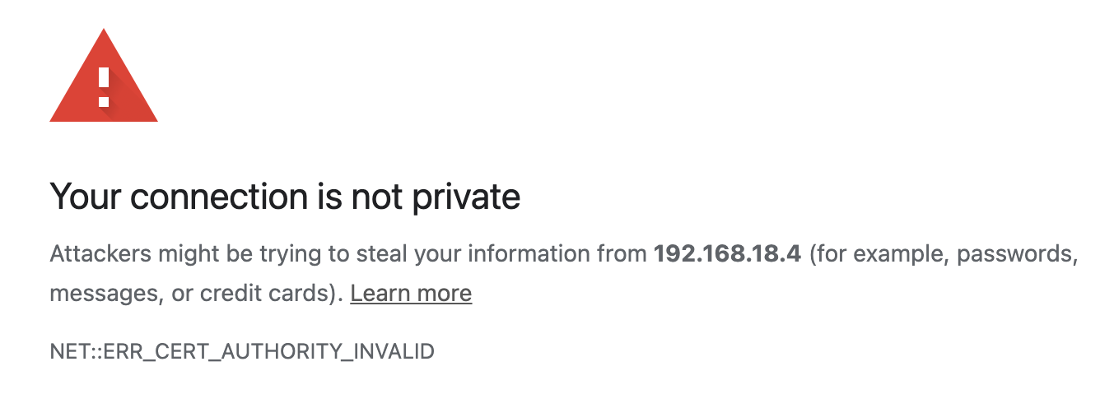
Threat Mitigation: Trusted Code
Preventing the man-in-the-middle with SSL
HTTP Request
Encrypted request
HTTP Response
Encrypted response
client page
(the “user”)
server
amazon.com certificate
(AZ’s public key + CA’s sig)
Notes:
Now, if there is a man-in-the-middle, the user can notice this immediately, and not transmit any information to the untrusted server

Slide 31
SSL: A perfect solution?
Certificate authorities
A certificate authority (or CA) binds some public key to a real-world entity that we might be familiar with
The CA is the clearinghouse that verifies that amazon.com is truly amazon.com
CA creates a certificate that binds amazon.com's public key to the CA’s public key (signing it using the CA’s private key)
Notes:
How does SSL work? Is it a perfect solution?
(read slide)

Slide 32
Asymmetric encryption: aka public key/private key
Each actor creates two keys:
A public key, which it publishes. This tells the world: if you want to send a private message to me, encrypt it with this key. Then only I can decode it.
A private key, which it keeps secret. The private key is what the actor uses to decode the messages that are processed by the public key.

Slide 33
Asymmetric encryption, aka public key/private key
When a node B wants to send a message to node A, it obtains A’s public key and uses it to encrypt the message
Only A can decrypt the message using its private key
Computationally expensive; usually only used for authentication
cyphertext C
K%U@Y…
plaintext P
ABCDE…
EKpubA(P)
plaintext P
ABCDE…
DKprivA(P)
cyphertext C
K%U@Y…
node A

Slide 34
Public/Private Key Encryption
Encrypt with public key: only private key holder can decrypt
Public Key
Private Key
Plain text Message
Encrypted Message
Plain text Message
Notes:
Here’s another visualization of this.

Slide 35
asymmetric encryption can be used for authentication, too
Encrypt with private key: anyone with public key can decrypt and be confident about who sent it.
Private Key
Public Key
Plain text Message
Signed Message
Plain text Message
Notes:
This works the other way, too.

Slide 36
Certificate Authorities issue SSL Certificates
Certificate Authority
Amazon
CA private key
CA private key
amazon.com certificate
(AZ’s public key + CA’s sig)
amazon.com private key
CA public key
My Laptop
amazon.com public key
amazon.com public key
Some real-world proof that we are really amazon.com
CA public key
amazon.com certificate
(AZ’s public key + CA’s sig)
Notes:
Certificate authorities create SSL certificates using asymmetric (aka public/private key) cryptography.
Here is a a brief overview of the trust relationships when an SSL certificate is granted, and when it is checked by a browser.
The process starts out as follows:
Amazon.com has some public key and private key
Certificate authority has some public key and private key
Everyone who trusts the CA has the CA’s public key. This is distributed with OS’s. That is, we must trust the CA.
(build until proof of amazon.com appears on right) To acquire a certificate, Amazon.com will share their public key and some real-world proof that they are amazon.com to the CA
(build until certificate appears and moves back to left) the CA will use their private key to sign amazon’s public key, noting that they are endorsing this public key as being held by amazon.com
(build once) then, when we visit amazon.com, the server will present its certificate, which our browser can validate by checking that it is signed by the CA’s private key (which we do using the public key)

Slide 37
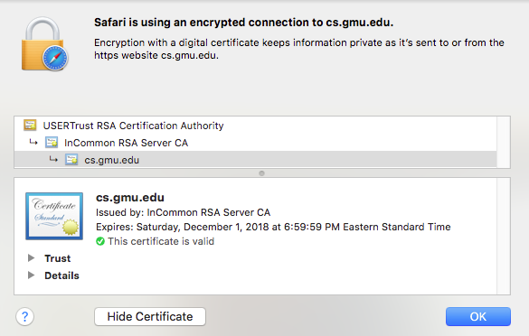
Certificate Authorities are Implicitly Trusted
Note: We had to already know the CA's public key
There are a small set of “root” CA’s (think: root DNS servers)
Every computer/browser is shipped with these root CA public keys
Notes:
Remember what we said before: you have to trust *somebody*. In this application, you have to trust the “root Certificate Authority”, just like you trust the root DNS servers.
(read slide)

Slide 38
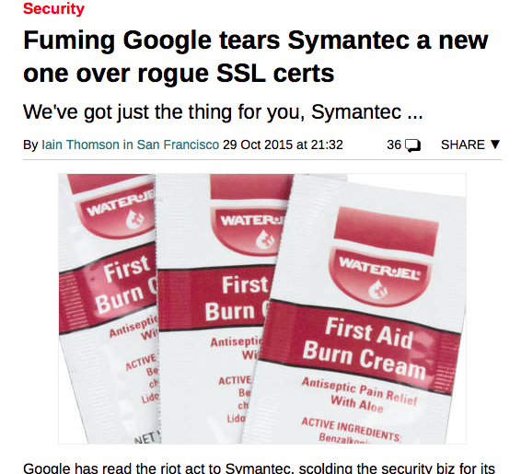
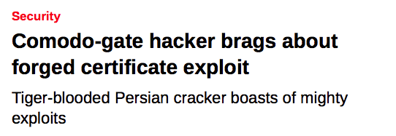
Should Certificate Authorities be Implicitly Trusted?
Signatures only endorse trust if you trust the signer!
What happens if a CA is compromised, and issues invalid certificates?
Not good times.
Notes:
(read slide, build in the two examples, both of which involved CA compromises)
As we saw, placing code in a trusted environment and using SSL to protect communication between trusted components is a great approach to mitigate threats to our execution environment (although it’s not a silver bullet).

Slide 39
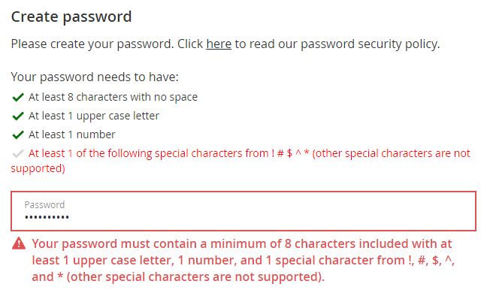
Threat Mitigation: Untrusted Inputs
Restrict inputs to only “valid” or “safe” characters
Special characters like <, >, ‘, “ and ` are often involved in exploits involving untrusted inputs
Simple fix: Prohibit such inputs using input validation
Notes:
Next, we’ll discuss threats posed by untrusted user inputs
(read slide)
Example shows input validation (Good), but it also seems pretty dumb to restrict the space of passwords to not include special characters besides those 5, both in terms of usability (annoying) and security (passwords are easier to guess because fewer possible characters).

Slide 40
Threat Mitigation: Untrusted Inputs
Sanitize inputs – prevent them from being executable
Avoid use of languages or features that can allow for remote code execution, such as:
eval() in JS – executes a string as JS code
Query languages (e.g. SQL, LDAP, language-specific languages like OGNL in java)
Languages that allow code to construct arbitrary pointers or write beyond a valid array index
Notes:
Here are some other possibilities for mitigating risks from untrusted inputs.
(read slide, some notes below)
Query languages might have “safe” apis and “unsafe” APIs, where the “Safe” APIs automatically perform some sanitization, allowing you to add place-holders for arguments to a query that YOU define, where the user-controlled input can ONLY flow into a specific part of the query (preventing the attacker from constructing their own query)
Last bullet is about avoiding C, buffer overflows, etc. Typescript and other “safe” languages always check array indices, so this is not a problem there, but there’s a cost in runtime or power.

Slide 41
Threat Mitigation: Software Supply Chain
Consider threats at each phase
External dependencies
Build process
Distribution process (including updates)
Operating environment
In-house code
Notes:
The “software supply chain” includes many potential points of weakness. We might need to consider threats at each phase of the software development and deployment process, including:
External dependencies: potential for malicious dependencies
In-house code: potential for insider attack (a developer who is either malicious, or whose laptop has been otherwise compromised through another vulnerability)
Build process: potential for build system to be compromised through another vulnerability or insider attack
Distribution process: potential for a malicious update to be pushed out to your customers
Operating environment: potential for other threats in the operating environment to result in a compromise of our software

Slide 42
Threat Mitigation: Software Supply Chain
Process-based solutions for process-based problems
External dependencies
Audit all dependencies and their updates before applying them
In-house code
Require developers to sign code before committing, require 2FA for signing keys, rotate signing keys regularly
Build process
Audit build software, use trusted compilers and build chains
Distribution process
Sign all packages, protect signing keys
Operating environment
Isolate applications in containers or VMs
Notes:
While we could easily solve problems in our own code by bolting on some useful additional components (like using SSL), it’s not so easy to solve threats to our software supply chain process – there need to be process-based solutions for these process-based problems.
These kinds of threats are currently some of the most-talked about (and most feared) because they are complex to defend against.
For example: how do we audit dependencies? Who does that, and when? What is “secure enough” for a dependency?
Who loves needing to do 2FA for every time you sign into canvas? How much worse is it if you had to do it for each git commit?
Signatures are useful only insofar as we trust the signer. If a developer’s computer is compromised (say, through a phishing attack), what good is that signature? Same for distribution.
Perhaps the best news-you-can-use here is to isolate each application in its own container or VM, reducing the scope of security breaches to be isolated within that environment and not directly impacting other applicaitons

Slide 43
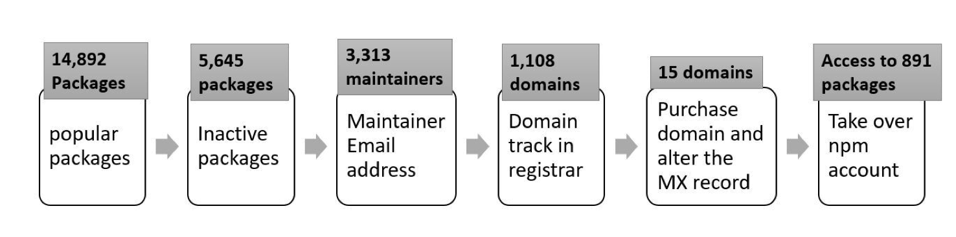
Weak Links in Software Supply Chain
2021 NCSU/Microsoft Study
8,498 NPM packages are maintained by at least one maintainer whose email address is inactive and could be purchased
33,249 NPM packages include installation scripts that can be exploited to run arbitrary code on developers’ machines at installation-time
5,645 NPM packages are not actively maintained
“What are Weak Links in the npm Supply Chain?” By: Nusrat Zahan, Thomas Zimmermann, Patrice Godefroid, Brendan Murphy, Chandra Maddila, Laurie Williams https://arxiv.org/abs/2112.10165
Notes:
Study included 1.4m security-sensitive packages on NPM – those that are depended on by others, and also have a license, a source code repository, and are not deprecated.
The graphic shows how an attacker might find a popular package to take over, starting from popular packages (top 10k by dependents and top 10k by downloads), then filtering to those that are not actively maintained (unlikely that anyone is carefully looking), then those that have email addresses that are expired. Then, for those 1,108 emails, we find the emails with domains that are available for sale by a registrar, finding 15 domains, that if purchased, would allow an attacker to reset the maintainer’s password, allowing takeover of 891 of these popular packages.
Whose job is it to fix this? NPM’s business model is really to sell premium products to enterprise customers. Does that give them an incentive to fix this? Who else could do it? (This paper was supported in part by Microsoft, which owns github)

Slide 44
Part 4: Which threats to protect against, at what cost?
Consider various costs:
Performance:
Encryption is not free
Preventing buffer overruns is not free
“Safe” languages like TS are usually (but not always) slower than optimized C.
Expertise:
It is easy to try to implement these measures, it is hard to get them right
Financial:
Implementing these measures takes time and resources
Notes:
So, where do we stand? We have discussed some threats, and some broad classes of defenses. Each of these defenses comes at some cost.

Slide 45
OWASP Top Security Risks
All 10: https://owasp.org/www-project-top-ten/
Broken authentication + access control
Cryptographic failures
Code injection (various forms - SQL/command line/XSS/XML/deserialization)
Weakly protected sensitive data
Using components with known vulnerabilities
Notes:
A good place to start with determine what to do about security in a particular application is to consider the common security risks for that kind of application.
In the context of web apps, the trade group OWASP (Open Web Application Security Project ™) maintains a top-ten ranking based on their severity and frequency. (The word “Risk” is intended to include frequency, severity, and likely cost of harm) Here are the top 5. We will discuss these specific vulnerabilities, and strategies that you can use to defend against them.

Slide 46
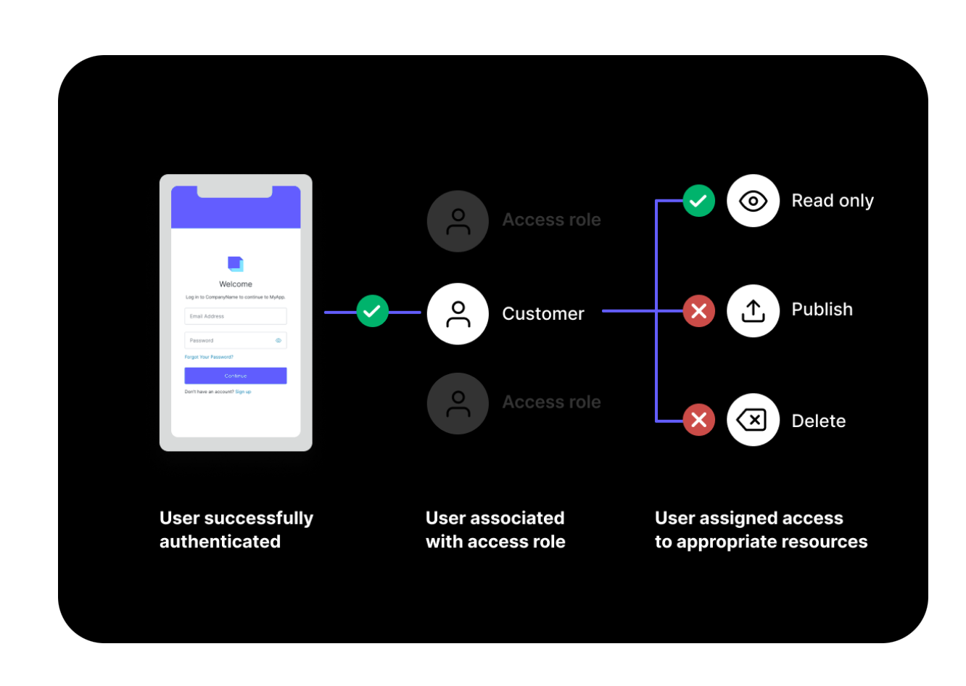
Mitigations for Broken Authentication + Access Control
OWASP #1
Implement multi-factor authentication
Implement weak-password checks
Apply per-record access control
Harden account creation, password reset pathways
Auth0
Don’t do this at home!
Use a trusted component instead
https://auth0.com
Notes:
Broken access controls are the most common class of vulnerability on OWASP’s 2021 list, and involve issues such as:
Bypassing access control checks by tampering with URLs or directly making API requests
Permit viewing/editing of other users’ content that is normally protected by “secret” URLs, where those secret identifiers are inadvertently disclosed
Privilege escalation – attackers can masquerade as other users
(click)
But doing this securely requires considerable expertise. A widely-used component is likely to do a better job than you can.
(click)
“Auth 0” is a third-party service that provides a generic authentication and access management for your application. Using a third-party service like this that can be trusted to “do this right” is a great software engineering strategy.

Slide 47
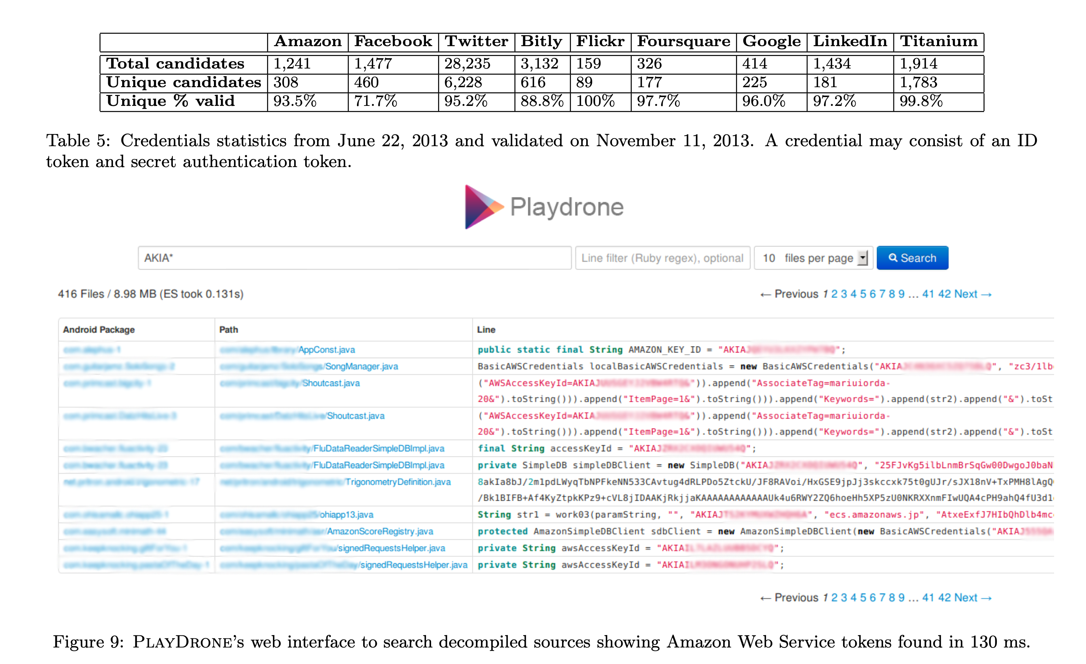
Cryptographic Failures
OWASP #2
Enforce encryption on all communication
Validate SSL certificates; rotate certificates regularly
Protect user-data at rest (passwords, credit card numbers, etc)
Protect application “secrets” (e.g. signing keys)
“A Measurement Study of Google Play,” Viennot et al, SIGMETRICS ‘14
Notes:
The second risk on the OWASP list is that of Cryptographic Failure.
There are a few strategies that apply generally
(read slide)
Validation -> certificates that you issue should be relatively short time-limited to limit damage in case they are compromised.
Certificates you use may have been compromised or may have expired. So it is important to check and not ignore expiration date of certificate
Application secrets – we talked about that last week in the context of static analysis, the right side shows the example we looked at last week.

Slide 48
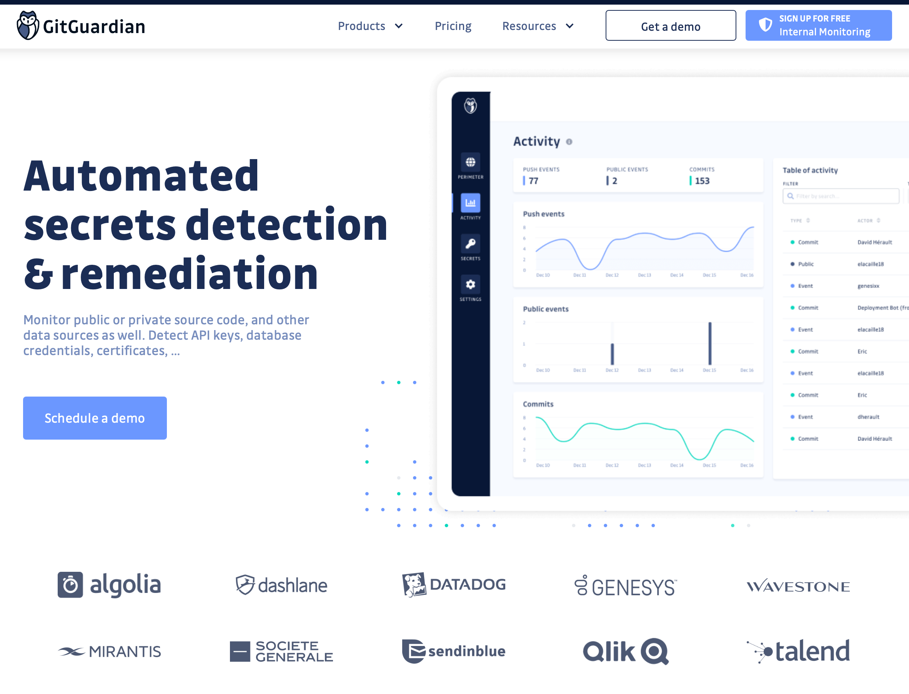
Static Analysis can help detect secrets at rest in a repo
GitGuardian (Launched in 2017)
Notes:
Automated credential checkers can help detect secrets that get inadvertently checked into a repository. We discussed this static analysis last week.

Slide 49
Cryptographic Failures
These are process-related issues and so require process-related solutions.
Secret detection tools are not enough
Industrial study of secret detection tool in a large software services company with over 1,000 developers, operating for over 10 years
What do developers do when they get warnings of secrets in repository?
49% remove the secrets; 51% bypass the warning
Why do developers bypass warnings?
44% report false positives, 6% are already exposed secrets, remaining are “development-related” reasons, e.g. “not a production credential” or “no significant security value”
“Why secret detection tools are not enough: It’s not just about false positives - An industrial case study”
Md Rayhanur Rahman, Nasif Imtiaz, Margaret-Anne Storey & Laurie Williams https://link.springer.com/article/10.1007/s10664-021-10109-y
Notes:
Simply using a secret detection tool isn’t enough. This is an interesting study (published 3/22-- just last week!)
(Read slide for key findings)
Discussion:
Bypassing warnings for false positives (e.g. not an actual credential) are reasonable (although perhaps annoying); the remaining reasons that are “development related” such as: * It is not a production credential (for example, it is a credential for a non-shipping prototype)
The credential doesn’t protect any data, service, etc., with significant security value
Rely on judgement calls of the developer that do not reflect overall security model. Many successful attacks rely on chaining multiple vulnerabilities together, getting a foothold in one system to then be able to access another. These kinds of judgement calls should not be made at the level of individual developers who may not see the whole security landscape.
Other reasons why secrets not promptly removed:
* Removing the credential now would break services. etc., that belong to other teams
We were not sure what secret management/other solution we can use to resolve the problem.
(click)
These are process-related issues and require process-related solutions.

Slide 50
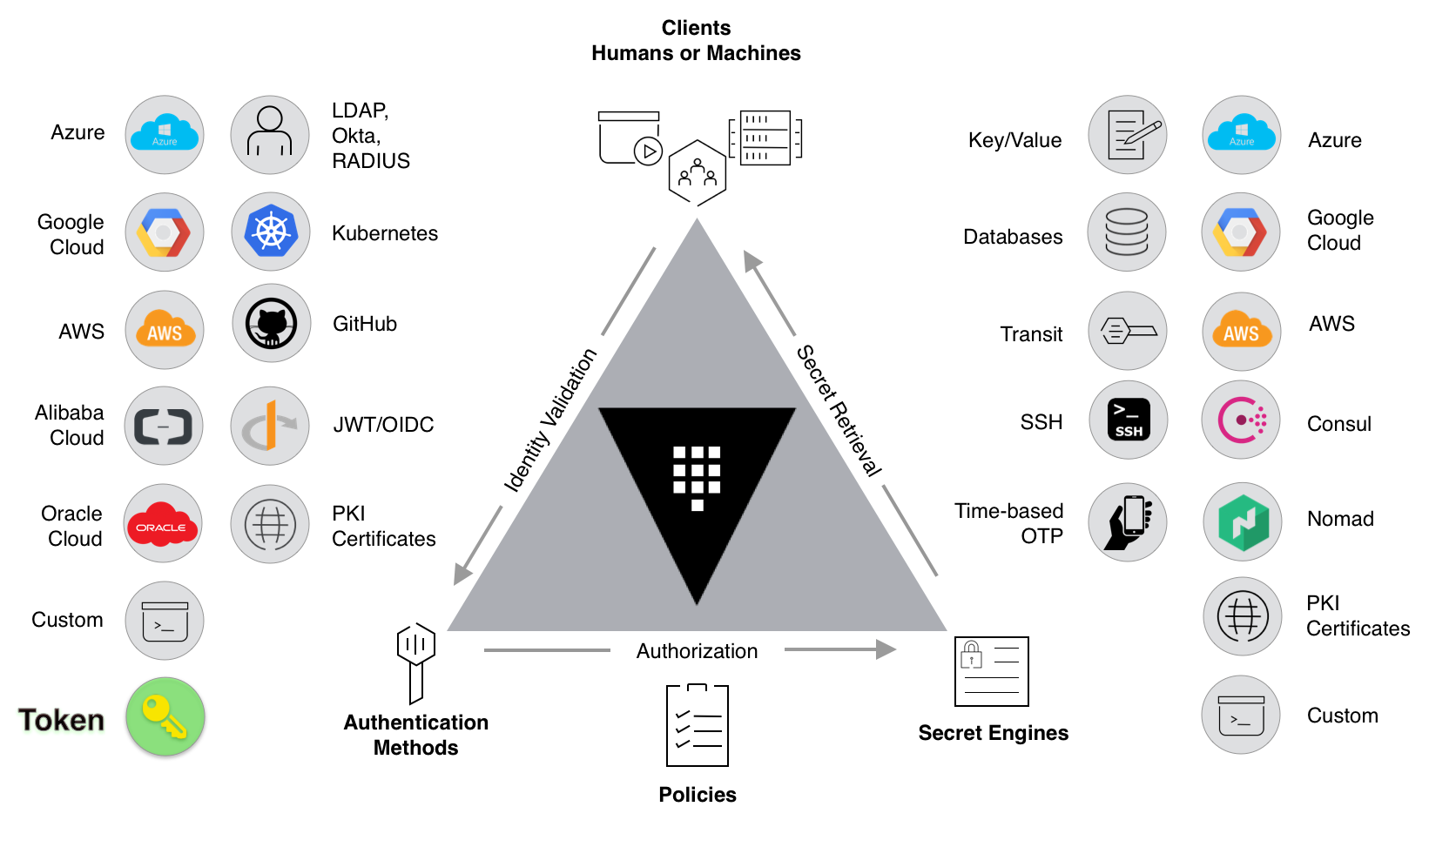
Cryptographic Failures
Secret management tools (“Vaults”) centralize points of failure, and automates:
Authorizing access to secrets
Providing time-limited secrets
Audit secret access
Example platform: HashiCorp Vault (open source, or cloud-hosted)
https://learn.hashicorp.com/tutorials/vault/getting-started-intro?in=vault/getting-started
Notes:
“Secret Management Tools” (sometimes called “vaults”) allow you to implement complex access policies.
(Read slide)
Key idea is that you can use a system to dynamically authorize access to external secrets using internal secrets.
Left side of figure (identity validation) shows authentication methods that clients (humans or machines) can use to prove their identity when requesting access to a secret credential.
Then, the vault checks policies that YOU define to say which users or services should have access to which secrets (bottom of figure, “authorization”)
Then, the right side of the figure shows various kinds of secrets that the vault might provide. Simplest form is providing access to key/value pairs (think about how GitHub actions stores “secrets” as simple key/value pairs, students added their twilio and Heroku secrets there).
Vaults allow for much more powerful, automated behavior when providing secrets - they might be able to automatically generate time-limited secrets for specific providers. For example, instead of providing AWS credentials, the vault might use its own AWS credentials to generate new, short-lived (e.g. 24 hours?) credentials that can be used to access the relevant AWS services. This limits the exposure of these secrets: even if they are breached, after a day the risk subsides.
Vaults also support auditing.
Hashicorp vault (where this image comes from) is an example of a secret managmenet tool, it is available as OSS, or cloud-hosted. Even though the OSS version is “free”, it is non-trivial to set up such a system and integrate it with an app. But, can be much better than putting secrets directly in code.

Slide 51
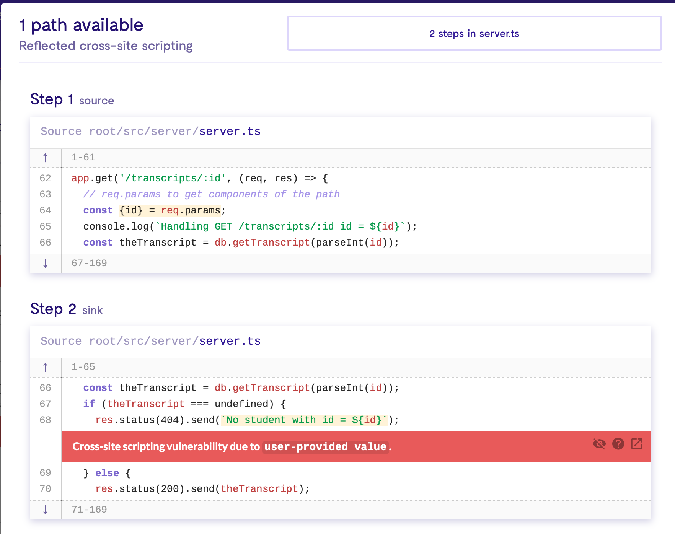
Code Injection
OWASP #3
Sanitize user-controlled inputs (remove HTML)
Use tools like LGTM to detect vulnerable data flows
Use middleware that side-steps the problem (e.g. return data as JSON, client puts that data into React component)
Notes:
OWASP risk #3 is Code Injection, which we talked about earlier
(read slide)
Screenshot on the right shows the LGTM tool identifying the cross-site scripting vulnerability that we discussed earlier.

Slide 52
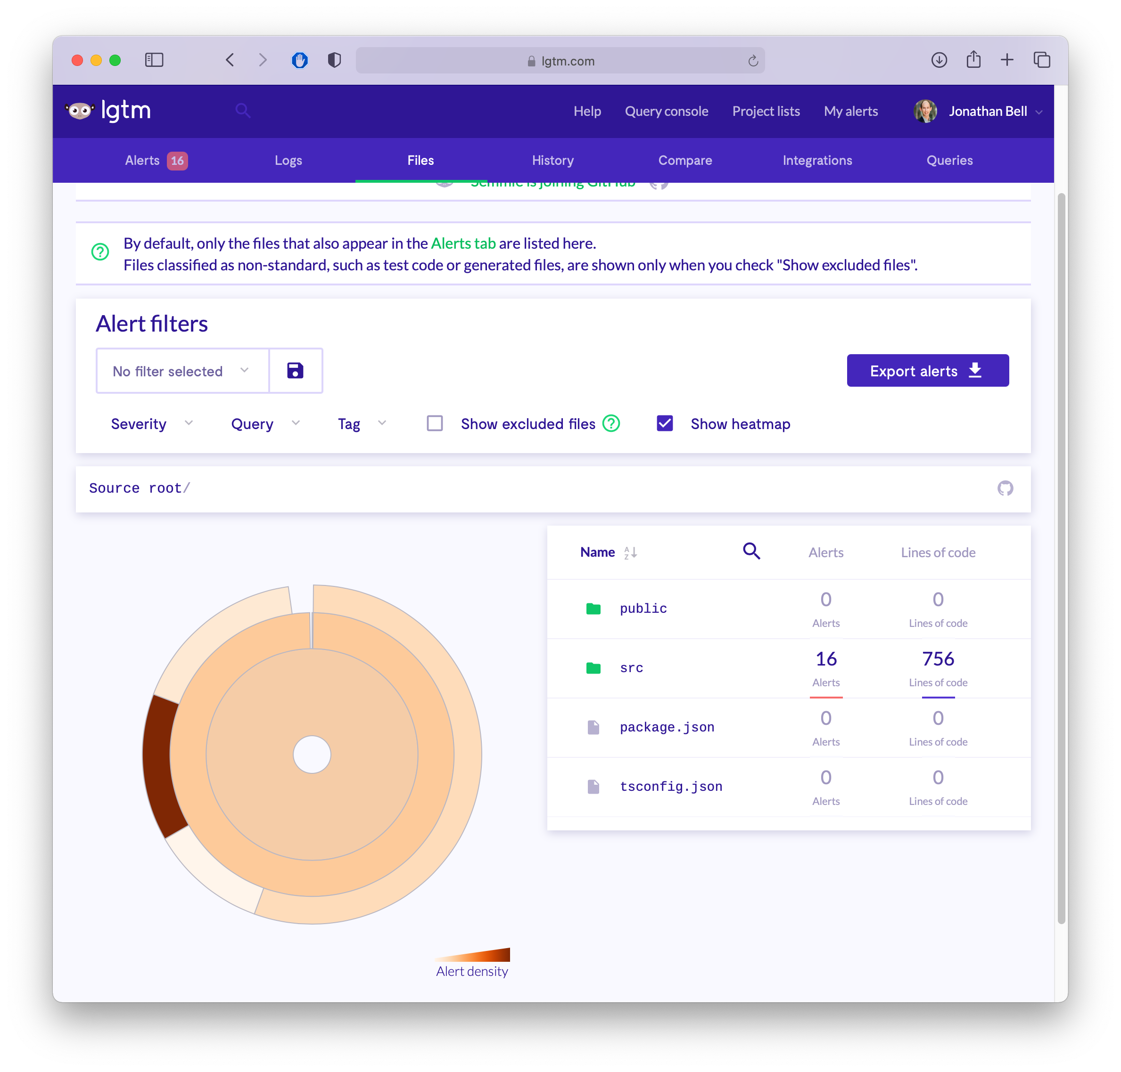
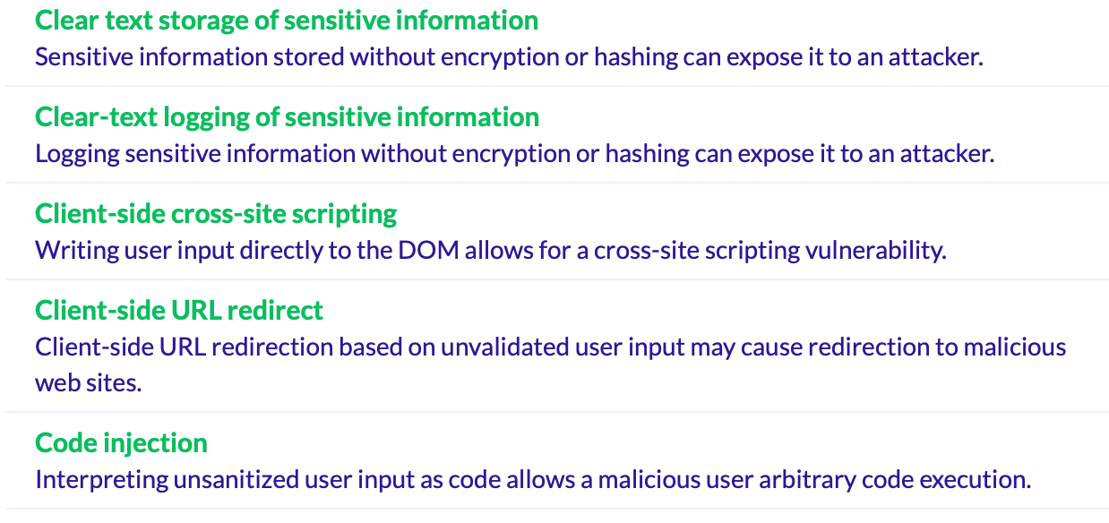
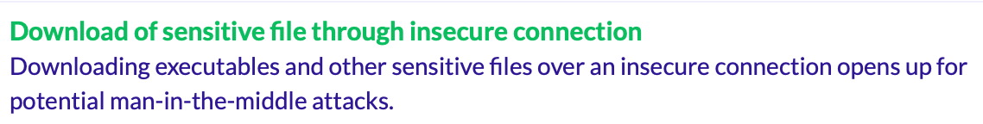
Detecting Weaknesses in Apps with Static Analysis
LGTM + CodeQL
https://lgtm.com
Notes:
LGTM can be used to detect other kinds of weaknesses, too – examples listed on right.
Of course, these tools are also imperfect – false positives (reports of things not exploitable) and false negatives (missed vulnerabilities)

Slide 53
Weakly Protected Sensitive Data
OWASP #4
Classify your data by sensitivity
Encrypt sensitive data - in transit and at rest
Make a plan for data controls, stick to it
Software engineering fix: can we avoid storing sensitive data?
Payment processors: Stripe, Square, etc
Notes:
(read slide)
If I add a pay-with-stripe functionality to covey.town, I will use the third-party service, so I never even see your credit card number. (Like SSO services “sign in with Google” or Auth0). (This is another example of “don’t do this at home”)
Of course this means I have to trust the 3rd party provider, and they need to worry a *lot* about securing the sensitive data! (But they have a lot of incentive to do so).

Slide 54
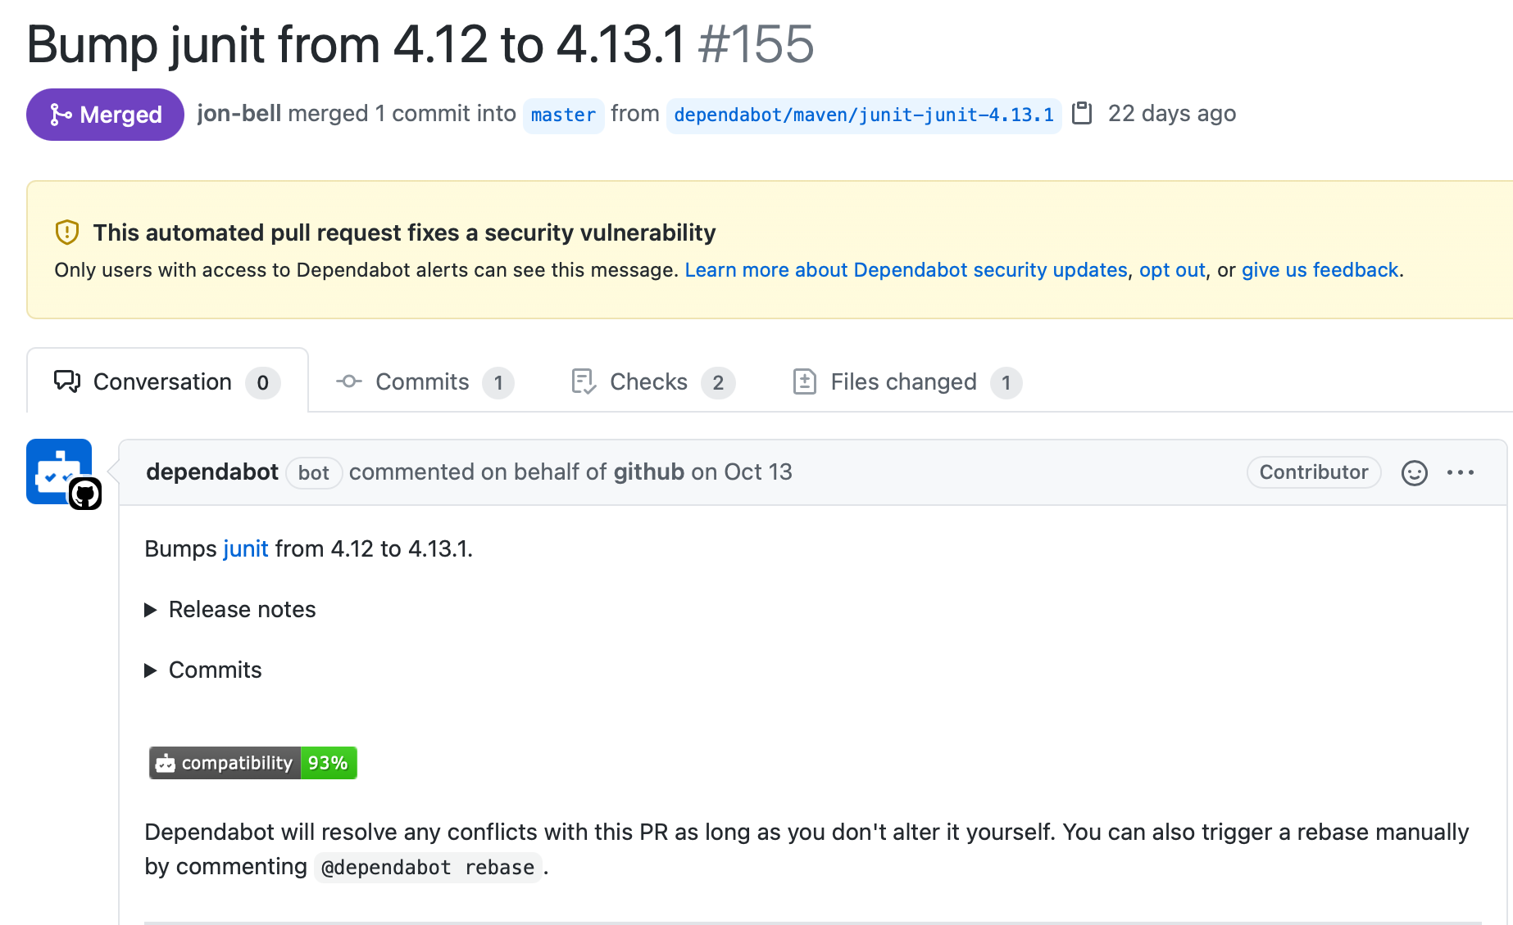
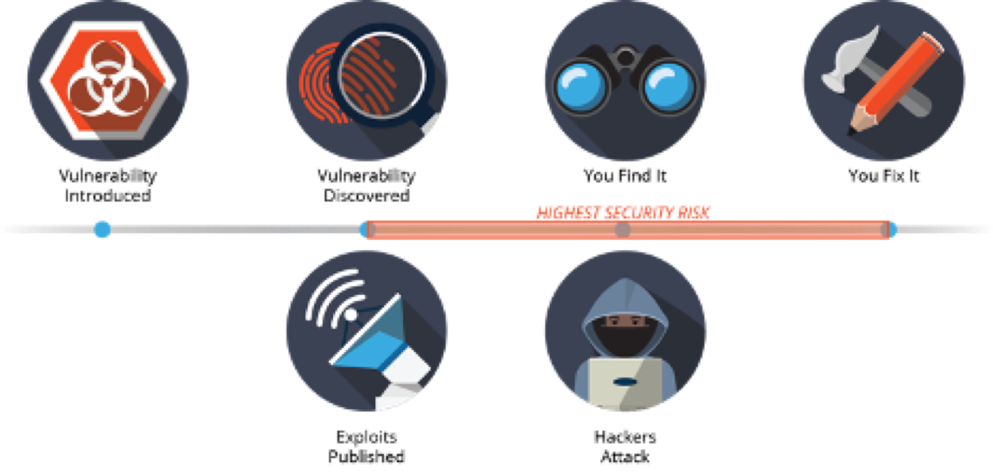
Using Components with Known Vulnerabilties
OWASP #5
Notes:
We also briefly discussed this weakness last week in the context of static anlaysis. As a refresher…
(point out figure on left shows risk window, figure on right show result of static analysis to find vulnerable dependencies and suggest upgrades)

Slide 55
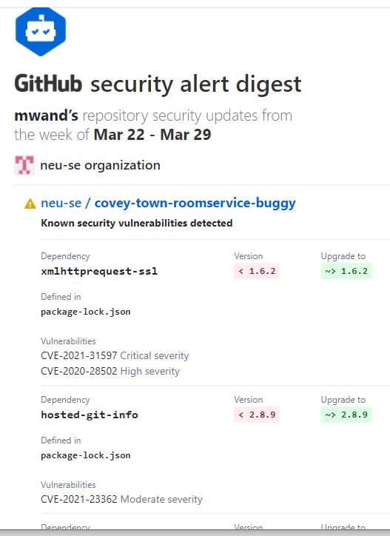
Dependabot will also send you an email

Slide 56
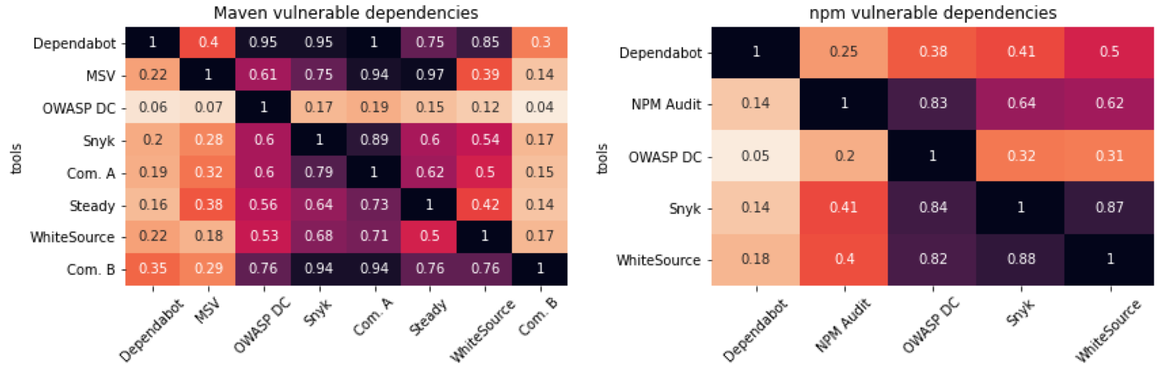
Using Components with Known Vulnerabilties
Static analyses are imperfect
Study: Vulnerable dependencies reported on a large, open source project, OpenMRS. Compare results across tools.
“A comparative study of vulnerability reporting by software composition analysis tools ”
Nasif Imtiaz, Seaver Thorn and Laurie Williams https://dl.acm.org/doi/10.1145/3475716.3475769
Notes:
This recent research study compared the results of several different vulnerable dependency analysis tools for both java (where dependencies are managed using a tool called maven) and javascript (dependencies through NPM).
Summary: different tools give different reports. Not ready to rely too much on these.
----more details if time---
Figures show generally high variability in overlap of reports. Full details and analysis in the referenced study. Some tools reported far fewer results due to tooling limtiations (only OWASP DC and WhiteSource detected that some java projects included JS, and that there were then dependencies in that included JS).
Each tool also relies on its own mapping of component version to vulnerabilities, which can result in variable performance.
Commercial tool B (‘com b’) only reported vulnerabiltieis that were actually used during runtime (measured what was used by integration tests). Could be a good idea, or a bad idea.
Summary: These tools can be useful, but should not necessarily be relied upon.

Slide 57
Learning Objectives for this Lesson
By the end of this lesson, you should be able to…
Describe that security is a spectrum, and be able to define a realistic threat model for a given system
Evaluate the tradeoffs between security and performance in software engineering
Recognize the causes of and common mitigations for common vulnerabilities in web applications
Utilize static analysis tools to identify common weaknesses in code

